Slide 1
Sleeping with the enemy Is the age of collaboration really here ?
90s
2010
Notes:
The world of media agencies is pretty young but has seen very fast paced evolution in a short life span

Slide 2
Notes:
This is where the media agencies started, and while many have a view that they still pretty much do this and a little more, the fact is that their business has become more sophisticated

Slide 3
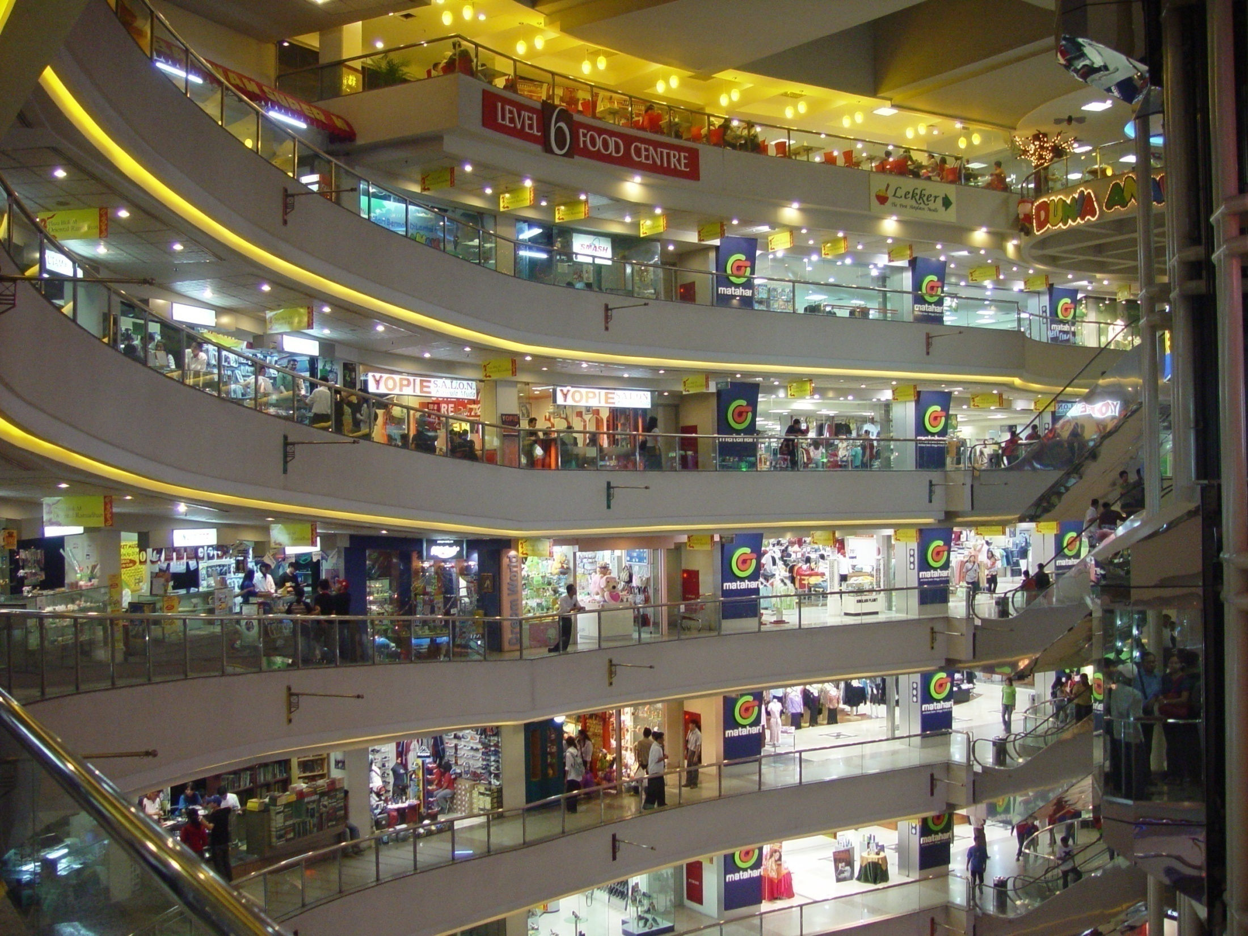
20th Century Agencies
Notes:
Any big media agency today prides itself on saying its the house of media. As they’ve grown you have a variety of ‘specialist units’ under the same roof, providing specialist services. The reality is that it wont be far from the truth if we call them a bunch of silo’ed departments, divided by their p&Ls. Who often do great tactical work, but rarely create a truly integrated marketing solution grounded in strategic insights. Who often end up competing amongst themselves, instead of collaborating, in order to win clients and revenue. And who are increasingly competing with specialist companies operating in the same domain as themselves. And also with the creative agencies who clearly dont want to miss out on the opportunity which emerges from this confusion

Slide 4
Dated self serving structures
Planning Team
Competitive Research
Syndicated Research
Insights
Analytics
Direct
Communications Planners
Multicultural
B2B
Search Engine Optimization
Promotions
Mobile
Word of Mouth
Entertainment
Planning Team
Digital Team
Search Engine Marketing
Sponsorship
Digital Analytics
Retail
Social Marketing
Gaming
Buying
OOH
Magazine
Newspaper
CLIENT
Digital
TV
Radio
Planning Team
Notes:
This is a typical chart many media agencies put up to frighten and confuse the hell out of potential and existing customers. It almost appears that the agency structure is designed to suit its short term business needs, rather than long term client needs in a complex and fast changing marketing and media landscape

Slide 5
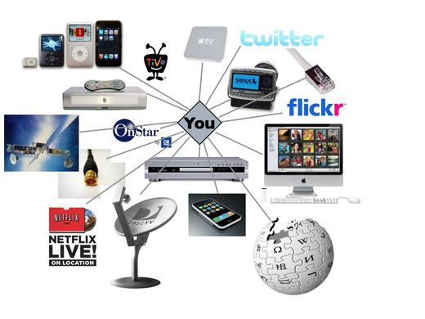
The world of creative agencies
What’s media?
Notes:
And then you have the creative agency model. They traditionally relegated media to the bottom of their own hierarchy. In response to client needs, their holding companies unbundled and consolidated media planning and buying into specialist media agencies. This was not so difficult in the era of push marketing when the media landscape was dominated by big TV networks and publishers and creative agencies knew they had to produce big advertising campaigns on TV and print. But its making life very difficult when marketing is no longer about pushing expensive TV commercials at sceptical consumers but engaging them and giving them value in exchange for their attention. In a complex media and marketing landscape it does not help to have a bunch of people coming up with marketing ideas with little understanding or involvement of the media platforms and how consumers engage with them

Slide 6
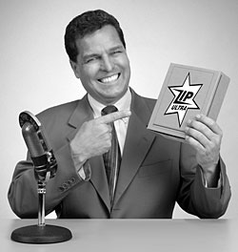
Compete, not collaborate
Notes:
So we now have a situation where media agencies are becoming dated commodity post boxes or boutique shops. And where creative agencies are confusing a big marketing idea with a TV campaign and are like a ‘dead man walking’. And you have the new media owners and research companies who seem to be competing with both of these for the marketers dollars and hoarding a lot of consumer data. None have the full solution or picture. Caught amongst all of them are the marketers, who are struggling to deal with even more complexity because of this

Slide 7
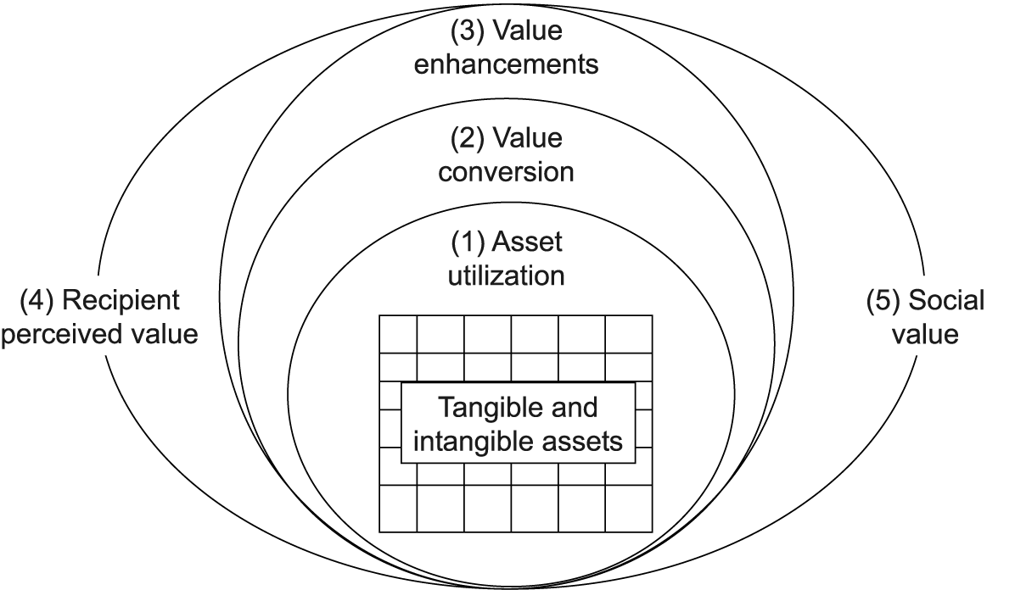
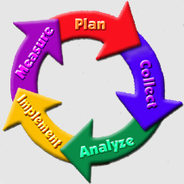
Lack of ability to demonstrate tangible value add outside of ‘cost’ and ‘price’
Notes:
As a result of this dysfunctional landscape, marketers are confused. There are no set benchmarks for evaluate the value added by any of their agency partners, and no recognised measures apart from cost

Slide 8
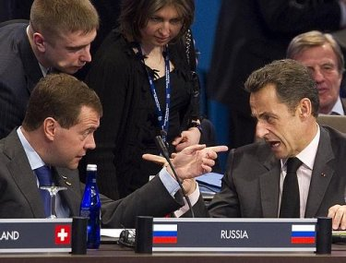
Procurement to complicate this volatile mix
Notes:
So they bring in procurement people to negotiate what they do best. Negotiate costs down. Hastening the demise of the existing business models which cannot survive in a highly commoditised, cost focused business. Forcing the media agencies to commit to deliver the cheapest cost and inventory and perpetrate the old world of push marketing.

Slide 9
Notes:
In the meantime, what’s the real world out there ? Marketing has become a lot more complex and consumers get brand experiences in a bewildering number of ways, especially on digital platforms. Consumers need to be engaged and persuaded and recruited to spread the good word about our brands. We want them to be advocates for our brands

Slide 10
Notes:
People interact with brand in more ways than just through paid for media. The media agencies now have to navigate and mange the new dynamic among paid for media, owned media assets and the earned media of talkability. What does it take to bring it to life.

Slide 11
Our new marketing reality
From…..
Owned
Paid
Earned
Owned
Earned
To…..
Paid
Notes:
Today, the emphasis is on traditional paid media. Owned media (content & sponsorships etc) bolted on, and typically from a different budget. Earned media opportunities accidental.
Tomorrow, start with development of owned utilities. Use paid media to activate/ promote. People pass/on and play with owned assets generating interest, credibility and WOM (offline and online)

Slide 12
“What are WE going to SAY TO these people?”
Notes:
Its no longer about what WE are going to SAY TO these people

Slide 13
“What are these people going to SAY about US?”
Notes:
BUT its what these people are going to SAY about us

Slide 14
…. with a singularity of idea (that you would love to shareTM)
Notes:
taking this endless palette of experiences and iterating to give people things that help them or let them iterate them for you…these are typically called mashups. Nike and Apple created the world’s largest running club and everyone’s experience is uniquely tailored and different..by the users themselves

Slide 15
So how will clients brief in the future?
“Get me 20% Revenue Growth”
“But we need to fulfil our monthly orders…”
“…and don’t let my brand get trashed on twitter”
2012

Slide 16
So what do we have to do?
Effective targeting
Adaptive marketing
Link our outputs to outcomes
Notes:
So there are three imperatives to navigate the new world of marketing.
WE should have the ability to target consumers based on their intentions.
We should be able to manage their brand experiences on a near real time basis and make changes as we go along
We should be able to plan their brand experiences based on the outcomes we want, using agent based simulation techniques.

Slide 17
The enablers Expertise in analytics Mastering data and technology
Notes:
Targeting by intention and linking outputs to outcomes in the new age marketing age needs expertise in data and technology
Technology has given us the ability to collect ‘feedback’ in near real time. Consumer ‘chatter’ creates a digital footprint. We can use the power of analytics to target consumers by intent. And we can start managing consumers’ brand experiences on a continuous basis, and plan and track outcomes.

Slide 18
CO - CREATION
BRAND DYNAMIC
CULTURAL DYNAMIC
IDEA YOU LOVE TO SHARE
Notes:
The other big enabler is what I call co-creation. Understanding the brand dynamics, the cultural dynamics and media as a force in popular culture, to come up with ideas consumers would love to share and facilitate that through the framework of paid owned earned media through their experience journey.
Both of these require multiple stakeholders, and experts to work together.

Slide 19
Surround,not
push
ADAPTIVE
MARKETING
From campaign to experience
management
From segmented
audiences to
individuals
Notes:
If you have the two enablers in place, you have truly adaptive marketing

Slide 20
IDEAS adaptable
to all channels
3 I’s of
ADAPTIVE
MARKETING
INTELLIGENCE for real time insights on customer behaviour
INTERACTION between brands & consumers
Notes:
This is driven by the 3 Is of adaptive marketing

Slide 21
Channel diversity
Create versatile ideas
Media specific creativity
Agile, iterative process
Notes:
Where the big idea is not confused with the creation of a 30 sec magnum opus on TV. Its about ideas that are created keepin in mind the diversity of channels we will use to engage consumers and which consumers may use to share their experiences with other consumers. Each media format works differently, and sometimes its role in popular culture gives it greater power in brand communication. Above all, we are not talking about a linear process here. Marketing is storytelling and to create and tell a good story we often need to go back and forth. This requires great deal of collaboration amongst those who are involved in its creation.

Slide 22
Generate conversations in all media
Map out consumer interactions
Seamless brand experience across channels
Track and respond
Notes:
Telling a story also means we need to completely understand the experience journey of consumers and where would we like to create interaction with what kind of channels. The goal is to make the story seamless across channels, to generate conversations, and to track and respond to the buzz

Slide 23
Understand implications of behaviour
Define success through customer intelligence
Track individual customer value
Turn intelligence into action
Notes:
And in order to link output to outcomes, set KPIS through use of analytics to enable customer intelligence

Slide 24
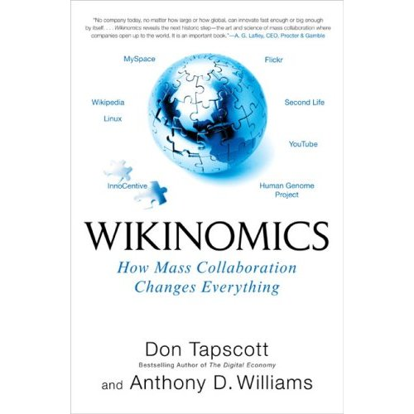
What does it take to make this happen?
Notes:
Leave you with two points here to kick off the discussion – The first is about collaboration. Given that so many different partners are involved, its about shedding egos and having a bunch of people with complementary skills work constantly together, irrespective of their organisational affiliations, to create great marketing programmes

Slide 25
What does it take, to make this happen?
Notes:
The second is about leadership. Its very important to have an owner of the entire programme. Someone who is versatile, can wield influence over multiple stakeholders, who is naturally accepted as a leader by the sheer weight of her or his ability to add value at any stage of the marketing storytelling creation and delivery.
This is the marketing spine. In some cases, you will have a client marketer who will play this role. In other cases this may come from one of the agency partners. My belief is that the media agencies should groom talent like this to take the lead, as their DNA is based on effectiveness, hard facts, consumer and channel knowledge.
With this, let me now hand you back to Sanjay…

