Slide 1
The Digital Distribution of Media:
The Opportunity

Slide 2
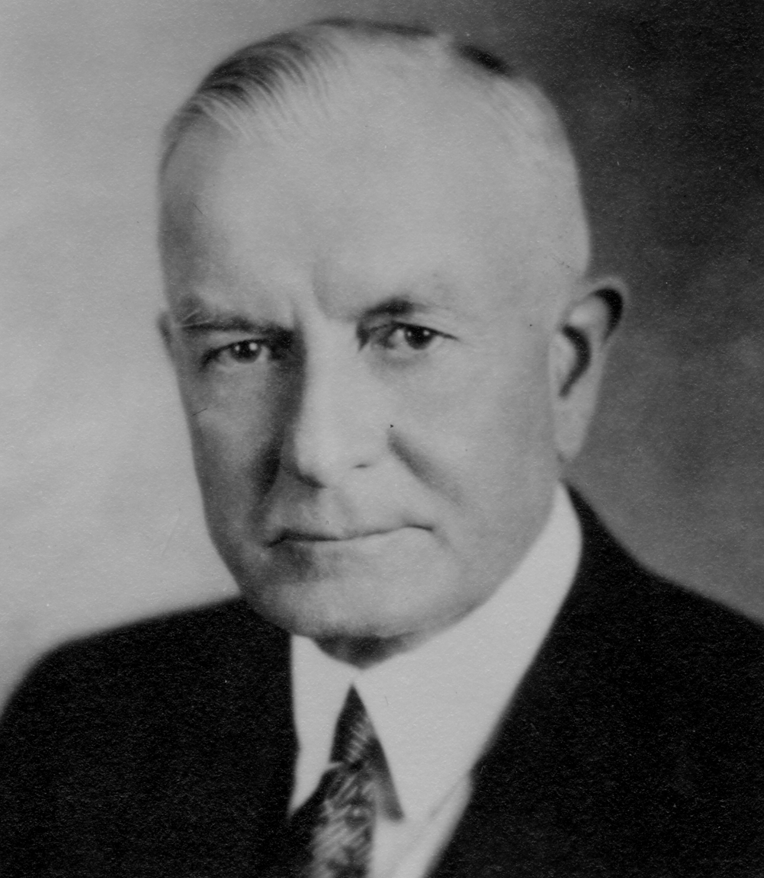
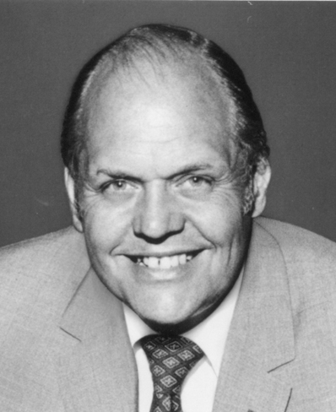
“I think there is a world market for maybe five computers”
Thomas Watson Chairman of IBM 1943
“There is no reason for any individuals to have a computer in their home.”
Ken Olsen President Digital Equipment Corp.

Slide 3
Content
Marketplace Factors
Technology
THE CONSUMER
Consolidations/ Mergers
Fragmentation/ Proliferation
Government Regulation

Slide 4
The new media isn’t new anymore

Slide 5
Today’s definitions for media are irrelevant

Slide 6
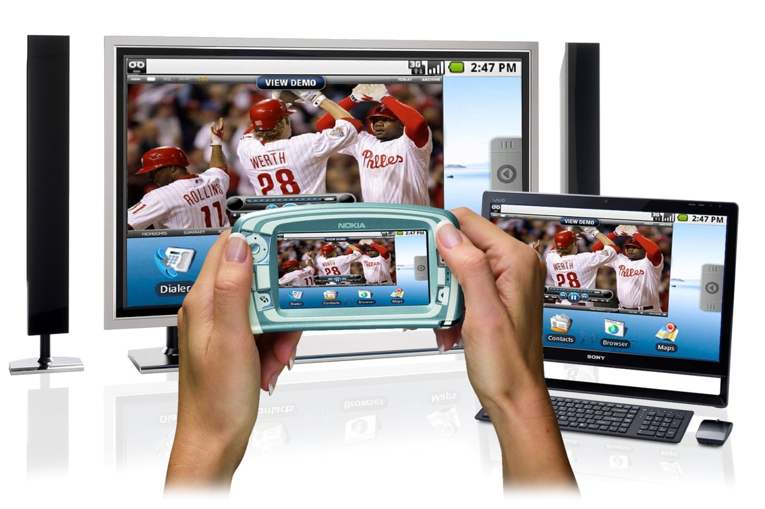
There will be three variations of media consumption:
BACK
FORWARD
MOBILE

Slide 7
Two consumption modes:
Linear
Non-Linear

Slide 8
Targeting moves from predicting behavior to reacting to intent

Slide 9
Reach AND engagement are essential.
We have a mandate to
deliver both

Slide 10
Cultural, technological and economic differences will continue to exist, and developing markets could be at an advantage

Slide 11
Need to work with media that is earned, owned and paid

Slide 12
Every form of communication will have addressability

Slide 13
The Digital Distribution of Media:
The Opportunity

